Slide 1
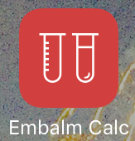
Embalm Calc presented by Tuesday Evening Publications

Slide 2
The Formula
C x V= C′ x V′
C= Index
V= Volume of arterial fluid
C′= Primary Dilution Factor (%)
V′= Total volume of solution
Bottle
Tank

Slide 3
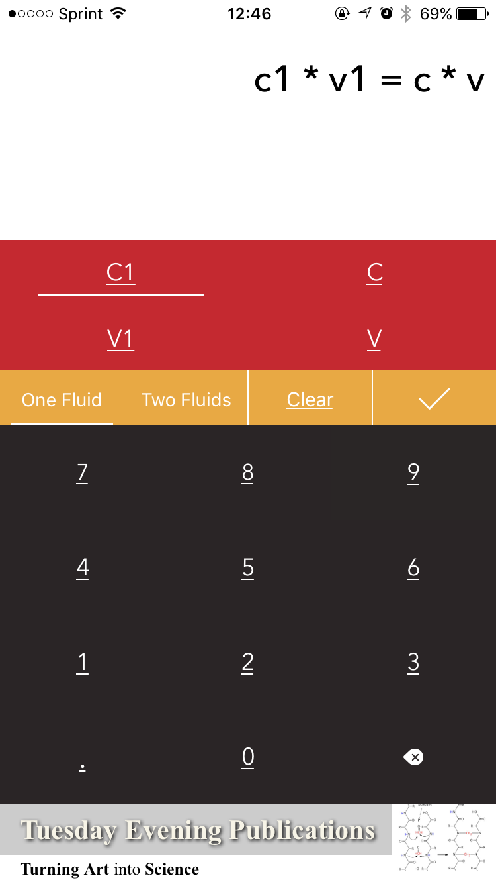
The App
Index
Fluid from bottle (oz or mL)

Slide 4
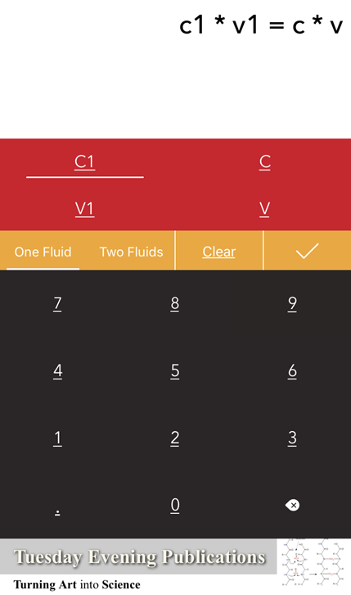
The App
Primary dilution factor (%)
Total Solution in tank (oz or mL)

Slide 5
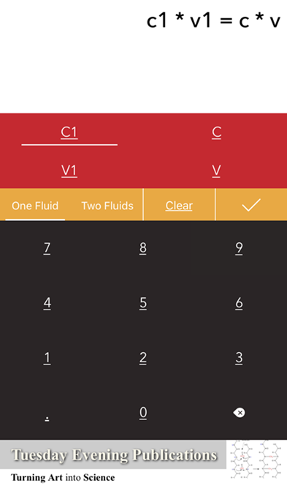
The App
Clear individual values
Choose 1 or 2 fluids
Delete numbers

Slide 6
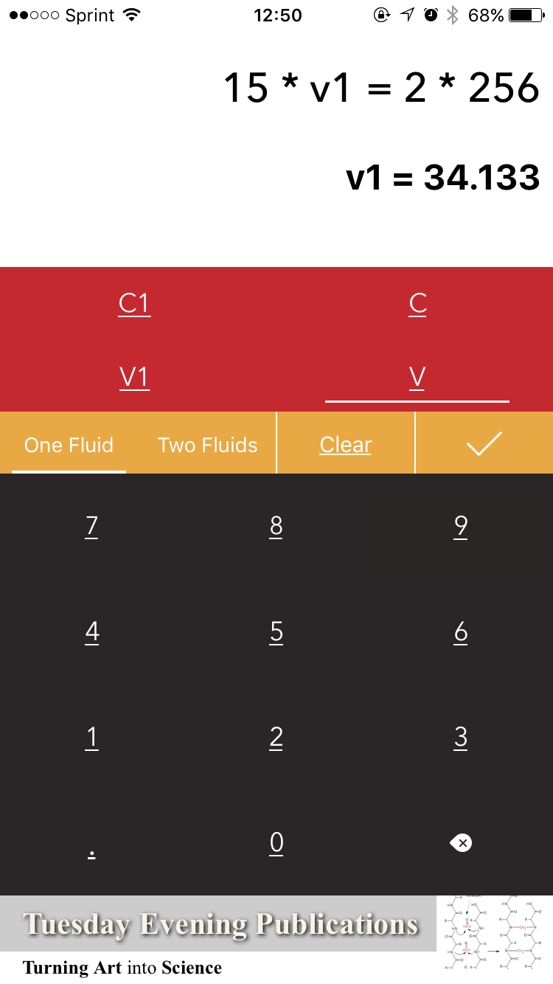
The App
Values Entered
Calculate Answer

Slide 7
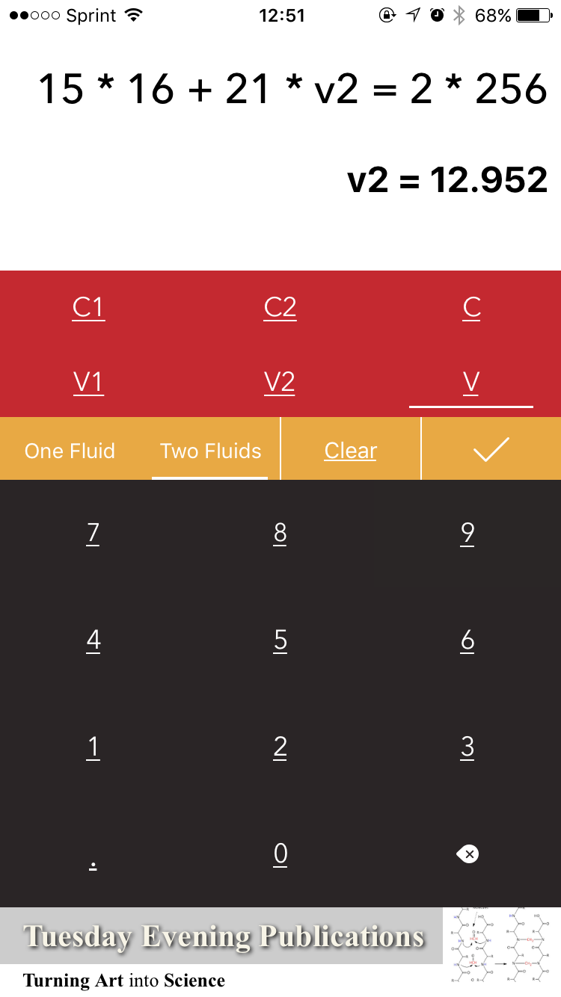
The App
Values entered
Check answers

Slide 8
Reference Slide
Standard bottle of embalming fluid= 16oz
1 gallon = 128oz
2 gallon = 256oz
3 gallon = 384oz

